Slide 1
Prison Reforms in the UK
Imran Ahmad Sajid, PhD
imranahmad131@uop.edu.pk
Source: Walter Friedlander. (1968). Introduction to Social Welfare. Pp.

Slide 2
General /Condition of Prison
The worst prisons in the world were in England
Two Types of Prison
Dungeons
Floating Hulks on River Thames
Jailers → Very Cruel
Alcohol → sold freely in prisons

Slide 3
1681– John Firmin
Two Types of People in Jail
Criminals
Debtors
Movement→ Lets pay the debt of debtors and release them from prison

Slide 4
1700– Society for Promoting Christian Knowledge
The Jailers found guilty of mistreatment should be dismissed

Slide 5
1728—General Oglethrope
Castell—Friend of Oglethrope
Imprisoned for debt in London Fleet Prison—a place where small pox was very common
Spent all his money, died in “Sponging House”
The House of Common appointed a commission to inquire about the jail conditions.
This led to some improvement particularly the prohibition of sale of liquor inside prisons.

Slide 6
1755– John Howard
A Very Rich person at the age of 16
1755—Earthquack in Italy
Went there for rehabilitation but…
The ship hijacked by pirates–
He found that every where the conditions of the prisons was the same _ unhealthy, dark, cold quarters, without air and light, insufficient food, no bedding, no blankets, and brutal treatment.
Howard imprisoned for 10 years in different jails of France, Italy and other European countries
Finally got released on pledge to find an exchange
He visited prisons in Holland, France, Italy and Switzerland and studied the conditions of the prisons there.

Slide 7
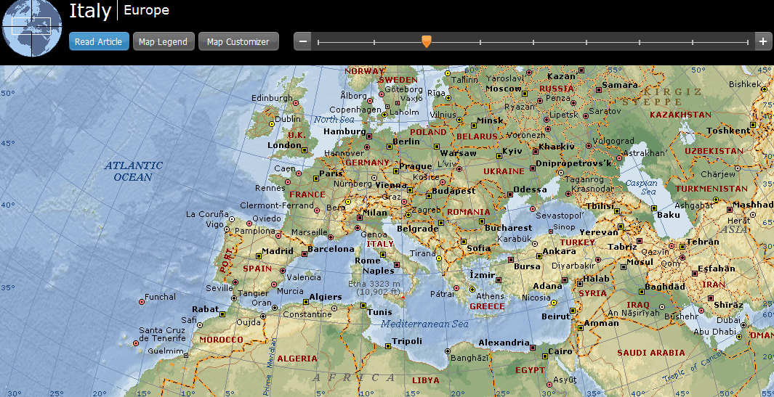

Slide 8
1773—Howard become Sherriff of Bedford county
1777—Book → On the State of Prisons in England and Wales
Called to parliament and started awareness
Better food, cleaning, bedding, medical care

Slide 9
1780—1845 Elizabeth Fry
Visited New Gate Prison, known as “hell upon earth”.
Started school for children in prison with a convict woman as teacher.
Introduced knitting and lace embroidery work.
Result:
Improved morale and created new hope in inmates.
Induced Order, industry and religion
Soon other philanthropist followed her footsteps

Slide 10
Youth Offenders
No separation b/w adults and youth offenders
Prisons as “Schools of Vice”
1847—Juvenile Offenders Act
Limited the criminal persecution of children >14 and adolescents >16 to specific cases of crime
1877—National Prison Commission
Prisons were transferred from the control of local administration to National Prison Commission
1894—Parliamentary committee request
Separation of young offenders from older convicts, and special treatment with vocational training

Slide 11
1897—Sir Evelyn Ruggles-Brise
Visited the US and studied Youth Reformatory at Elmira, New York.
1897—Borstal System
Special Correction of young offenders (Children >16) were to be kept separate in Borstal Institutions
1912—Special Courts for Children >14

